Slide 1
CAR #123911329Analysis for CAR Calibration Meeting
By Erica Qin

Slide 2
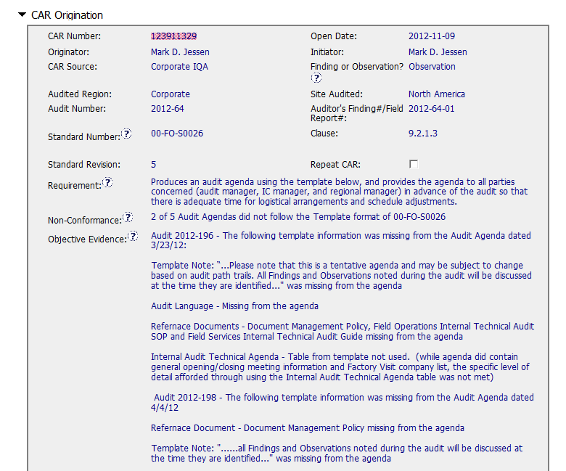
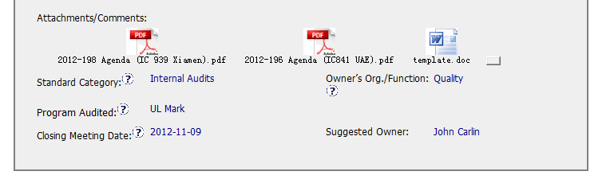
CAR No. 123911329 (1)
It’s recommended that the objective evidence should also cover the brief information ( eg. Agenda Number, issued date) of other 3 Audit Agendas, which will be more complete and accurate.
1
Referenced Template format is attached, very clear and easily identify those differnece.
Notes:
00-QA-S0006 (#18.0) - Corrective Action Request Process

Slide 3
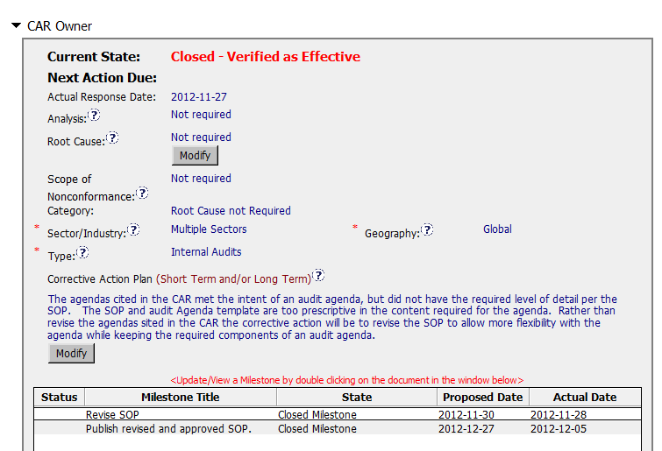
CAR No. 123911329 (2)
For Observation, “Not required” being filled in are appropriate.
The corrective actions that revising SOP(00-FO-S0026) can allow more flexibility to generate audit agenda, it’s proper to briefly clarify each NC points(4 items totally)and specify whether it is required item or optional one ,then resolve the template format issue. Also shall add “to publish the revised and approved SOP “into CAP field to match the 2nd Milestones.
2
Notes:
00-QA-S0006 (#18.0) - Corrective Action Request Process

Slide 4
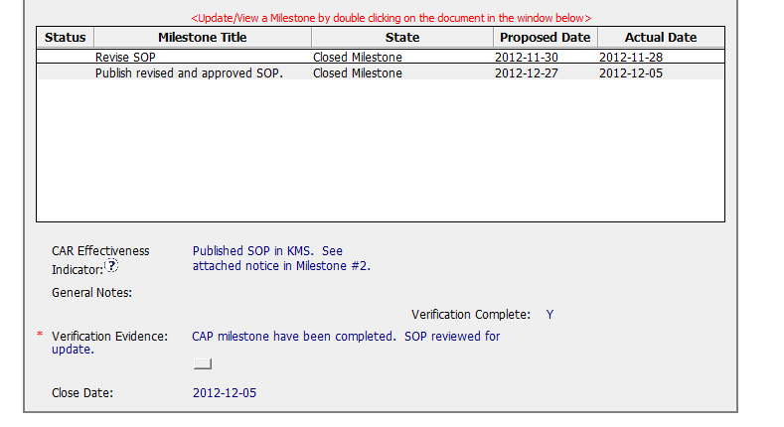
CAR No. 123911329 (3)
As the suggested method used to verify the CAP and Milestones effectiveness, the indicator should include published SOP implementation effectiveness results by checking audit agendas.
So the verification evidence should be further revised based on updated indicator for published document.
3
Notes:
00-QA-S0006 (#18.0) - Corrective Action Request Process

Slide 5
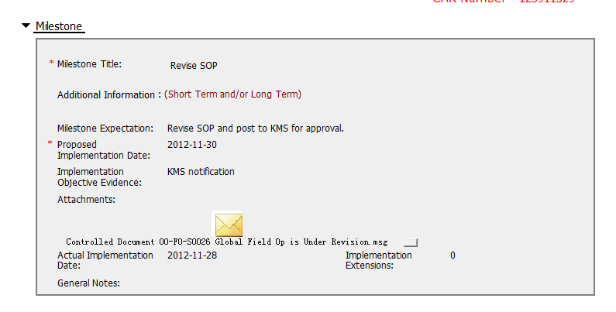
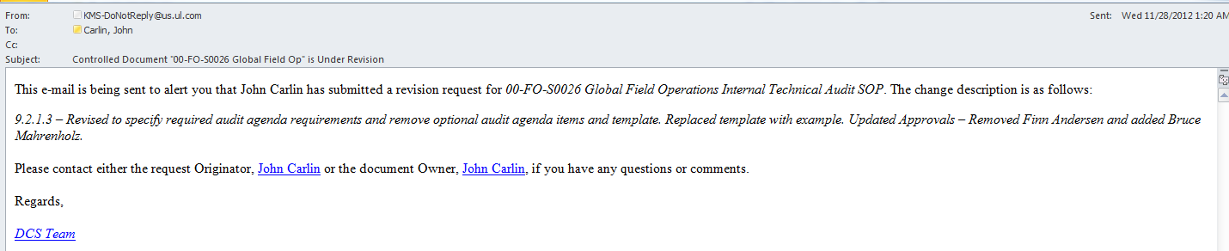
CAR No. 123911329 (4)
Use the email from KMS stating that the document under revision status.
Notes:
00-QA-S0006 (#18.0) - Corrective Action Request Process

Slide 6
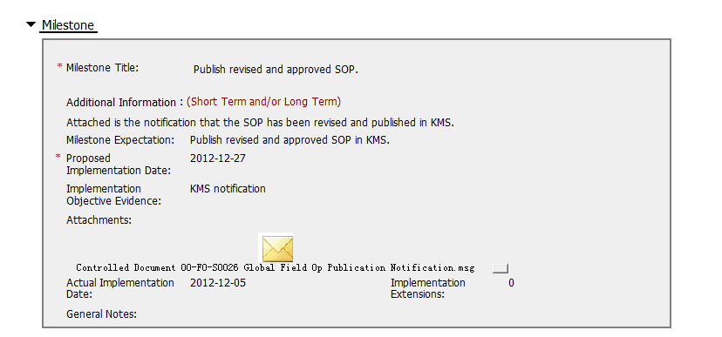
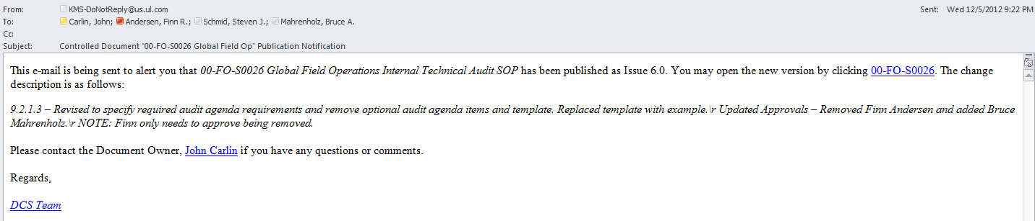
CAR No. 123911329 (5)
Has provided the email from KMS stating that the updated document has been published.
However, the updated, published document must also be attached per the Requirements for Published Documents in Milestones(refer to 1stQtr2012).
Comments: There should be evidence that shows how the new SOP was implemented.
This could include a proof of training/implementation that shows names/signatures of participant and the topics covered.
4
5
Notes:
00-QA-S0006 (#18.0) - Corrective Action Request Process

Slide 7
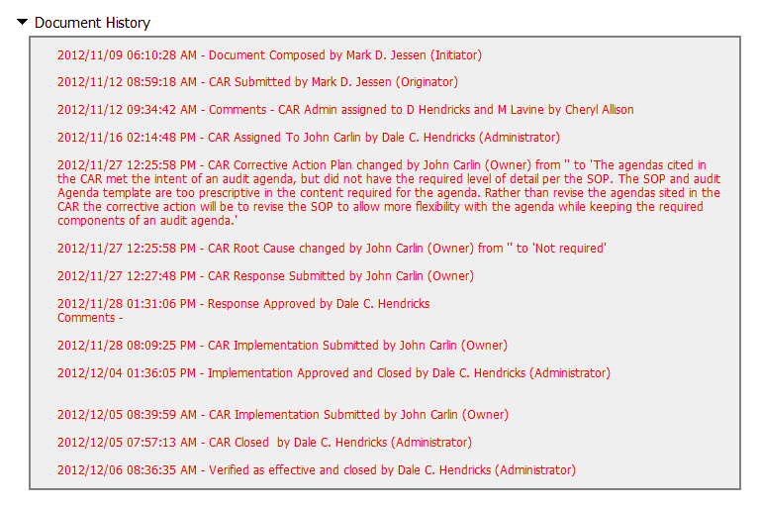
CAR No. 123911329 (6)
When accepting CAR Implementation, CAR Admin should ensure the CAP and all milestones must have corresponding evidence of effective implementation, for Milestone 2 lacking of the attachment of updated, published SOP 00-FO-S0026.
Due to this corrective action plan related to the audit agenda creation, the reviews for the new agendas must have taken place before closing the CAR or milestone.
6
Notes:
00-QA-S0006 (#18.0) - Corrective Action Request Process

